Slide 1
Current EARS IASI L1 and L2 Processing and Preparation of Future EUMETSAT Hyperspectral Missions
Dorothee Coppens, Thomas August

Slide 2
Outline
EARS (EUMETSAT Advanced Retransmission Service) programme
  Introduction
  Status of the IASI EARS level 1 processing
  Status of the IASI EARS level 2 processing
Using IASI EARS products to prepare the new programs
  Overview of the new missions
  Interactions with the new user community: NWC

Slide 3
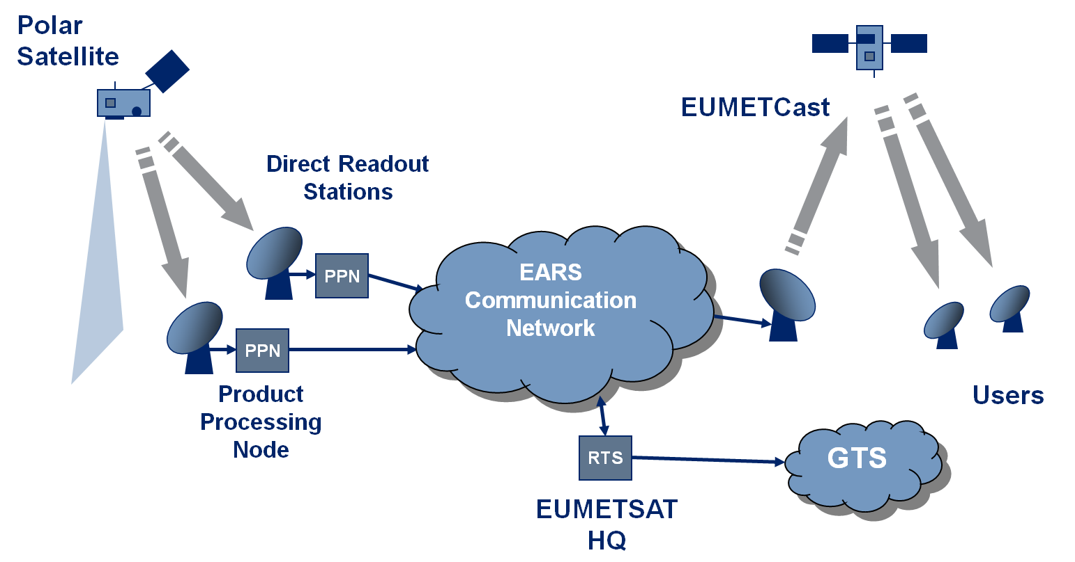
EARS – System Overview
10-30 Minutes

Slide 4
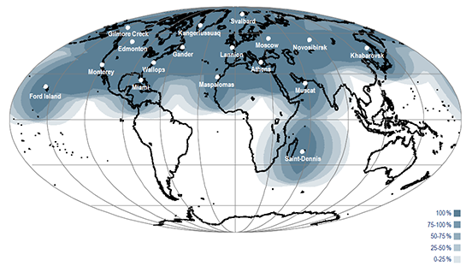
The EARS Ground Station Coverage
Five Core EARS European Stations
Contributing EARS Stations

Slide 5
Current IASI EARS processings

Slide 6
Status of IASI EARS Level 1 processing
IASI-EARS L1 processing is operational since April 2012
It runs currently IASI L1 processing version 7.4
Provides calibrated and geolocated IASI L1c observations in a combined product containing both Principal Component scores (PCS) and selection of 500 original IASI Channels, cloud/scene analysis information
PCS, representing the 8461 IASI channels by 90 scores for Band 1, 120 scores for Band 2 and 90 scores for Band 3.
Encoding of the 300 Principal Component scores and the 500 original IASI Channels in one BUFR product

Slide 7
Status of IASI EARS Level 2 processing
Based on IASI L2 ground processing, version 6.4
IASI-EARS L2 processing is in Pilot phase since Nov 2017
Provides the following geophysical parameters:
  Temperature profiles
  Humidity profiles (and integrated water-vapour total column)
  Surface temperature
  Surface emissivity
  Fractional cloud cover, from IASI L1C (AVHRR)
  Processing and quality flags
Using: IASI L1c, AMSU L1b, MHS L1b products

Slide 8


IASI L2 v6 processor overview, scope of EARS-IASI L2
L1
Statistical
retrieval
Cloud detection
Optimal
estimation
Atm.
comp.
L2
IASI
PWLR³
All-sky
OEM
AMSU
T, q, T_{s}, O₃
MHS
Single footprint
AVHRR
T, q, T_{s}
O₃
land emiss.,
cloud signal
Cloud
fraction,
top height,
phase
Dust index
O₃
CO
CH₄
SO₂
HNO₃
(CO_{2,} N₂O)
NWP
EARS IASI L2

Slide 9
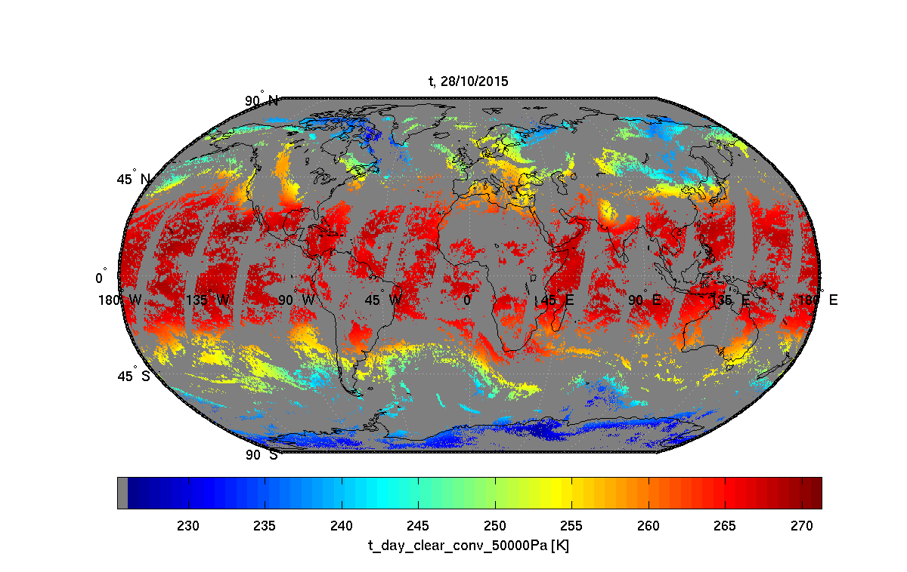
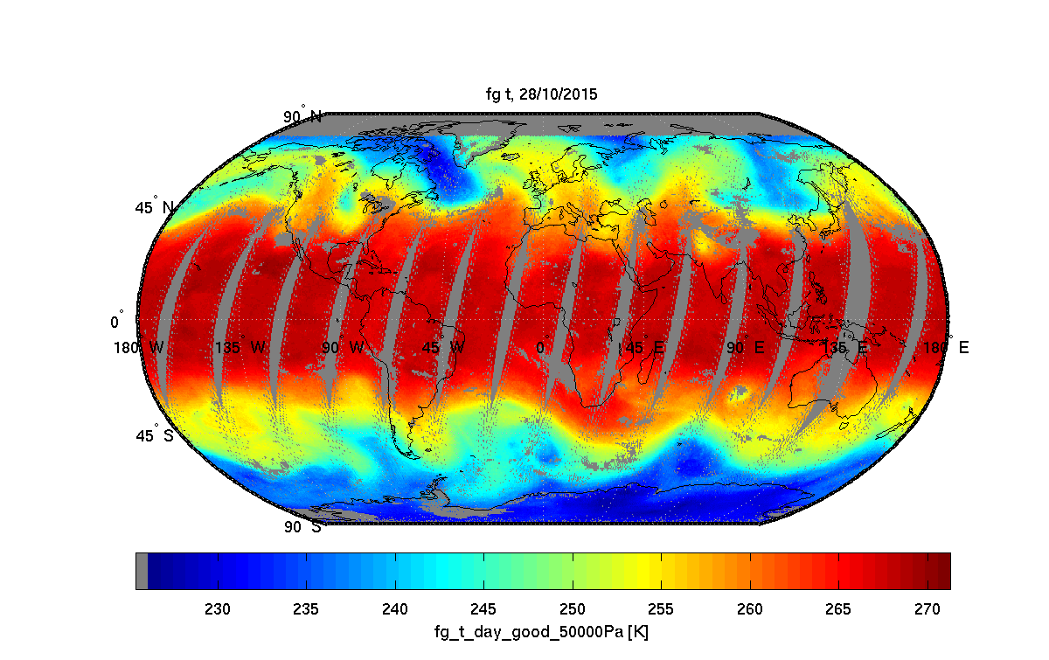
IASI L2 v6 products Typical useful yield
Clear-sky OEM
All-sky PWLR

Slide 10
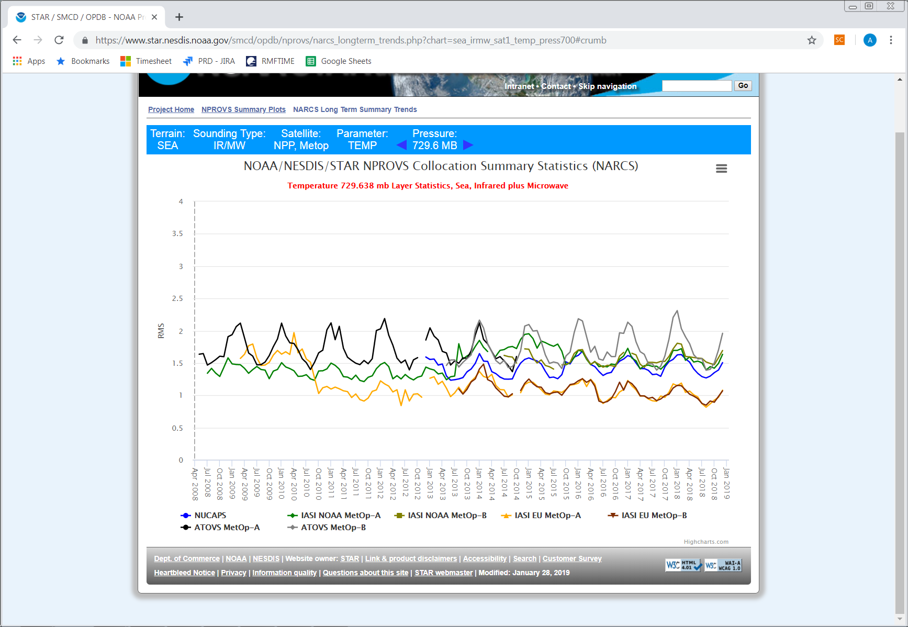
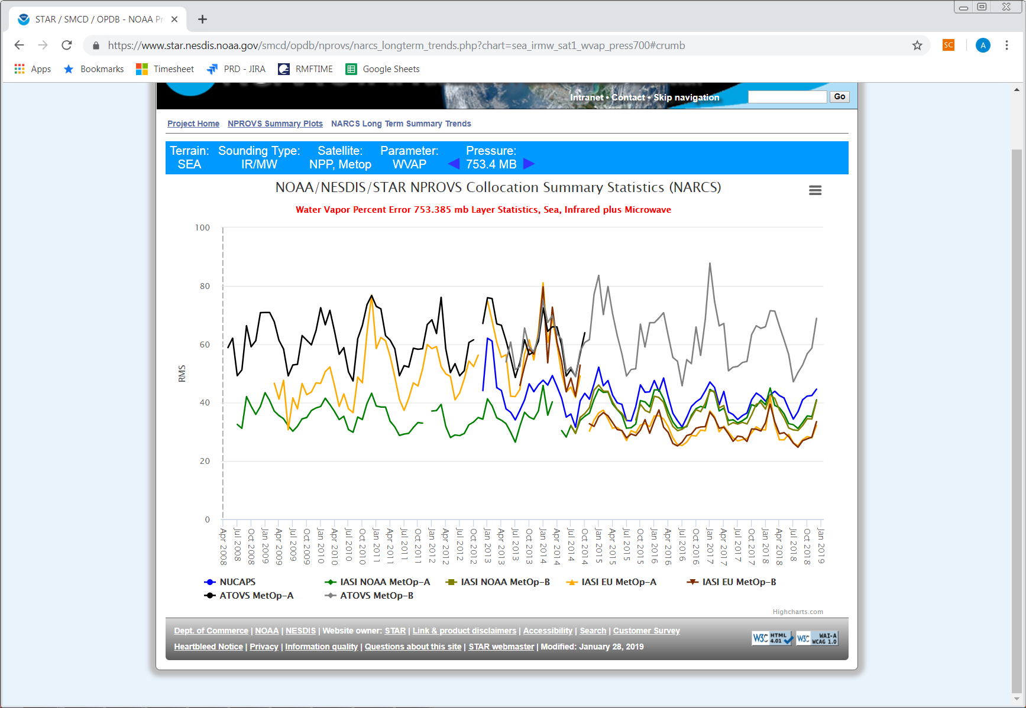
EUMETSAT IASI L2 products quality comparison to sondes
v4
v5
v6
T@730hPa, Sea
EUMETSAT
IASI L2
Metop-A
Metop-B
H₂0@750hPa, Sea
v4
v5
v6
2009
2010
2011
2012
2013
2014
2015
2016
2017
2018
2019
https://www.star.nesdis.noaa.gov/smcd/opdb/nprovs/
Credits: B. Sun, T. Reale (NOAA)

Slide 11
1. IASI L2 v6 performances Radiance residuals
Clear-sky Land - |lat|<60° - 01/11/2017
OBS – CALC(ECMWF FCT + CAMEL emissivity)
OBS – CALC(v6.4 + CAMEL emissivity)
OBS – CALC(v6.4 + retrieved emissivity)

Slide 12
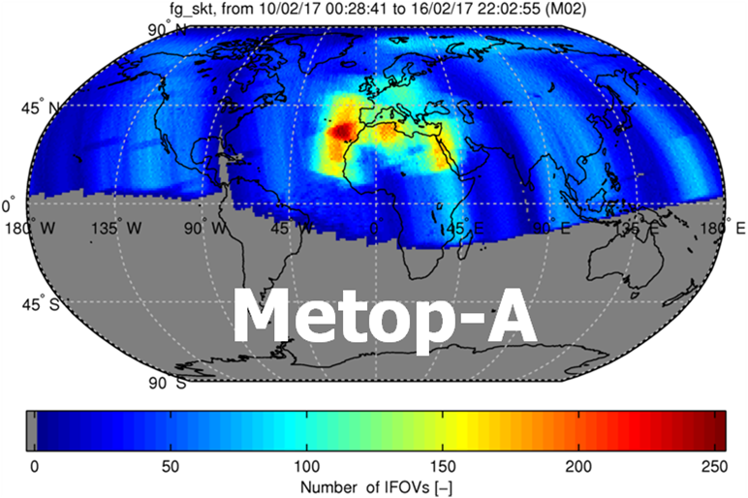
Example of the coverage with EARS-IASI L2 products from Metop-A,
between 10 and 16 February 2017

Slide 13
New missions

Slide 14



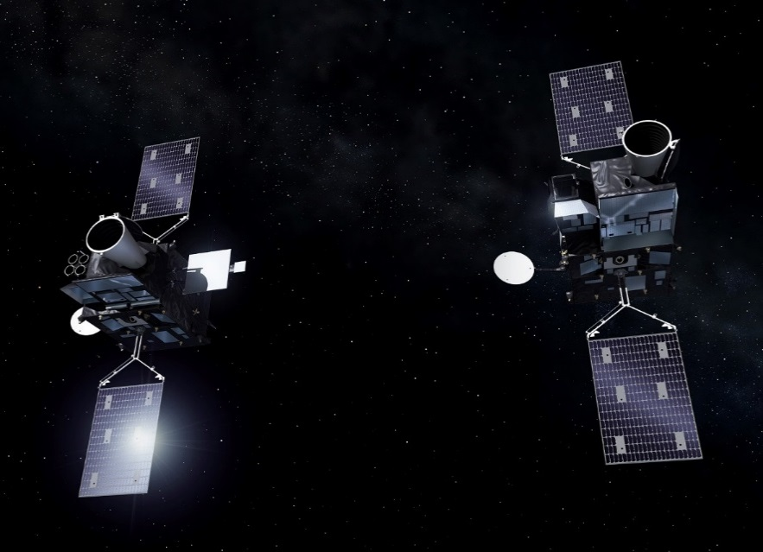
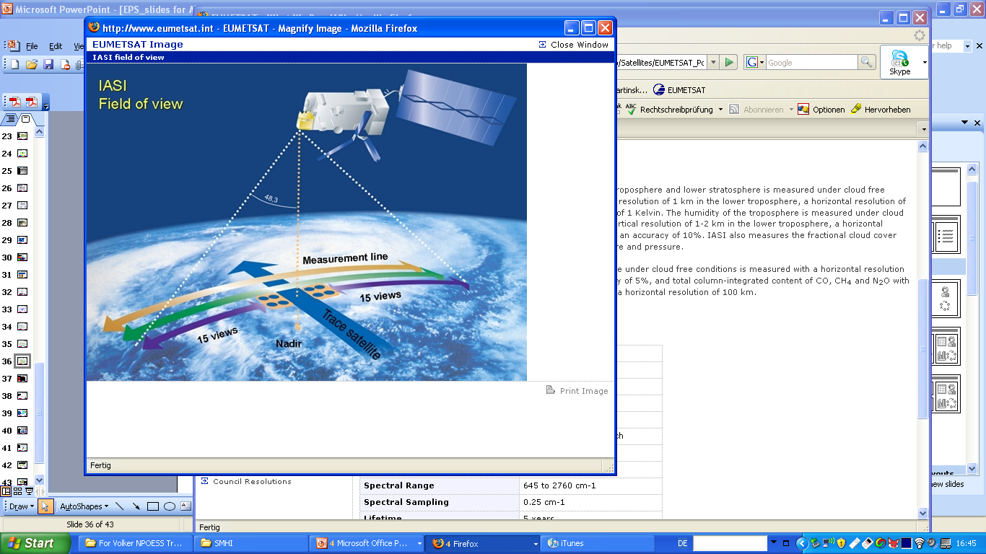
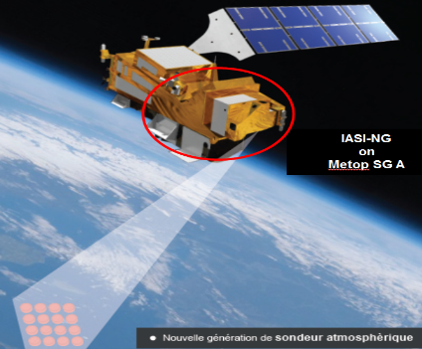

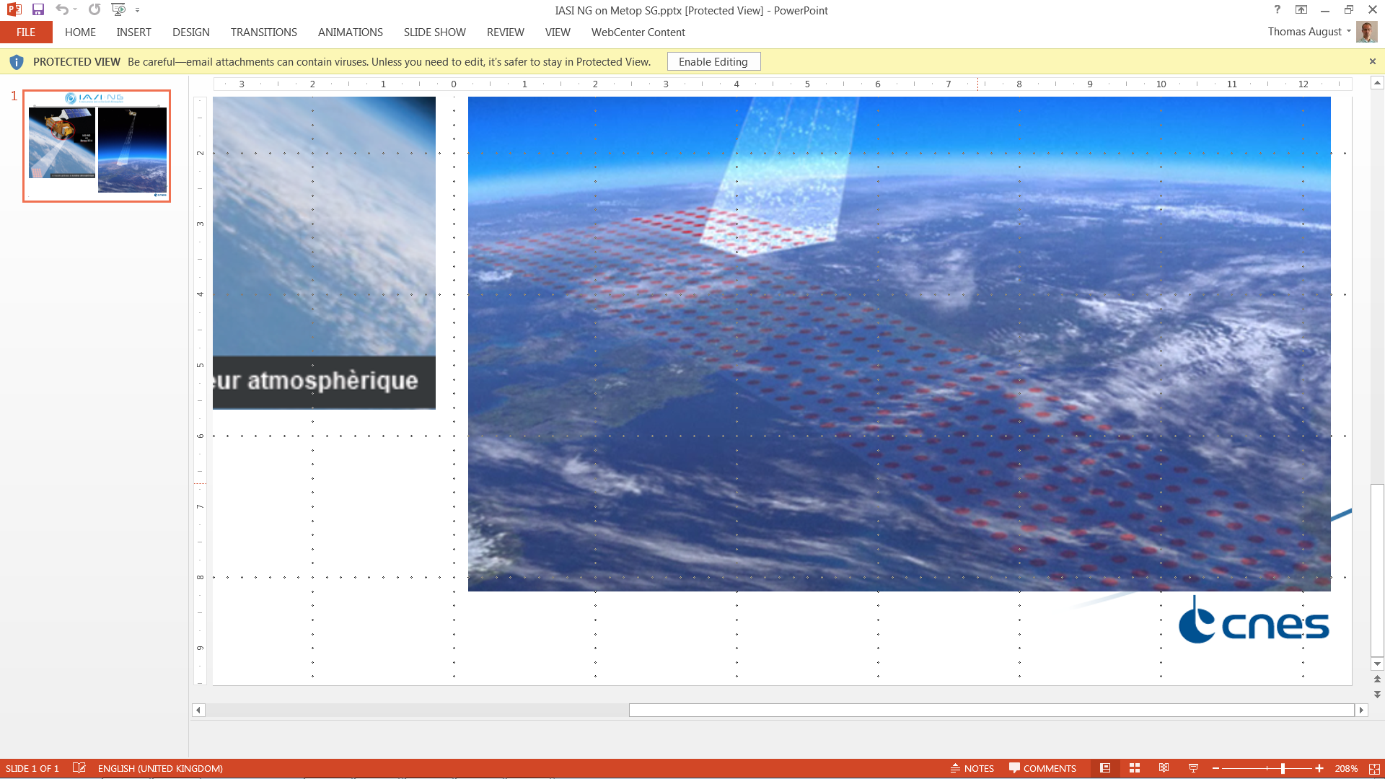

EUMETSAT hyperspectral sounders
IASI | IASI-NG |  | MTG-IRS
Low-Earth orbit sun-synchronous (~820km) |  | Orbit | Geostationnary
2x2 | 4x4 | Sensor | 160x160
12 km | 12 km | Spatial (Nadir) | 4 km
0.25 cm⁻¹ | 0.125 cm⁻¹ | Spectral sampling | ~0.6 cm⁻¹
2x / day | 2x /day | Temporal | Every 30 min Europe
Metop-A 19 October 2006 Metop-B 17 September 2012 Metop-C 06 November 2018 | 2022 |  | 2023

Slide 15
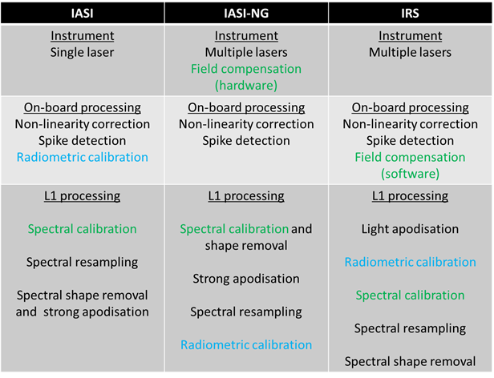
IASI-NG L1 processing
CNES is, as for IASI:
Responsible for the development of the IASI-NG instrument
Responsible for the development of the level-1 processor provided as CFI to the EPS-SG ground segment
will establish the IASI-NG Technical Expertise Centre (IASI-NG TEC)
IASI-NG L1 processing:
IASI heritage
Optimization of the calibration sequence: spectral calibration first

Slide 16
IASI-NG L2 processing
IASI-NG L2 processing is based on strong IASI L2 processing heritage with some additional requirements:
mainly on the clouds products:
    Cloud liquid water path (CLWP)
    Cloud Ice water path (CIWP)
    Cloud droplet size
more stringent requirement on the accuracy of the already existing products

Slide 17
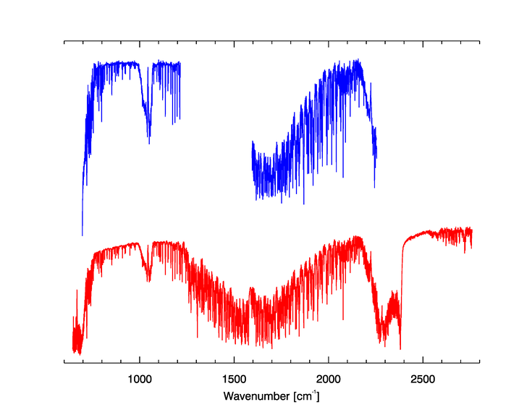
IRS instrument
    IRS is an imaging FTS, based on a Michelson interferometer:
  Corner cube mechanism (CCM) similar to IASI
  Multiple laser beams for monitoring the CCM speed variations as well as its 3D position
  Maximum OPD: ~0.828 cm (on ground) i.e. a sampling of about ~0.6038 cm⁻¹
  Detector: 160x160 pixels (640x640km) measured in 10 sec
  Two spectral bands: 700-1210 and 1600-2175 cm⁻¹ within IASI spectra
IRS
  IRS is a step forward wrt. IASI:
  New technology
  Larger field, better spatial resolution
  Higher temporal repetition
  Additional user community (Nowcasting)
  Different instruments ➔ different calibration
  methods
IASI

Slide 18
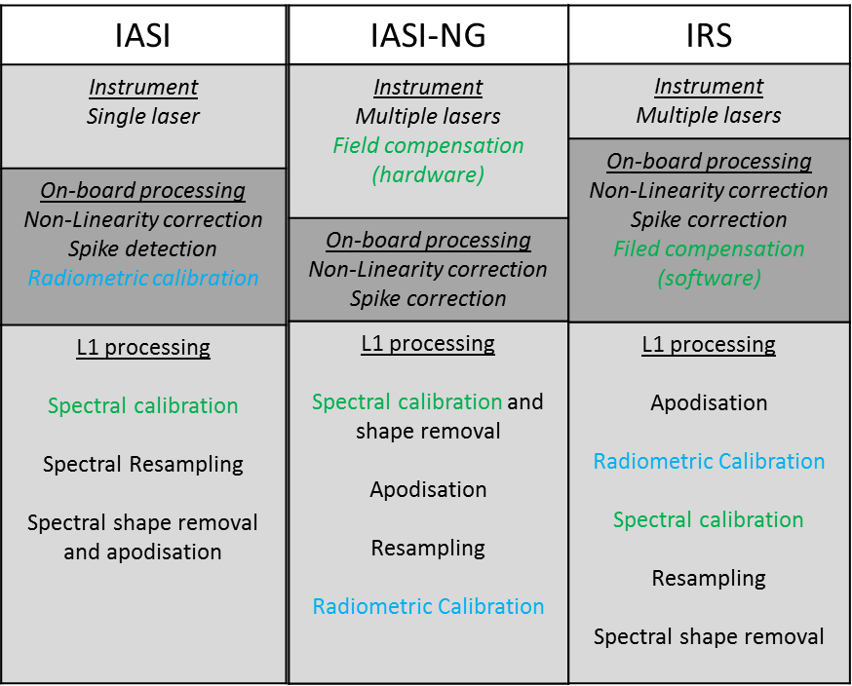
IRS level 0 and level 1 processing
    IRS instrument and on-board processing:
      Complex metrology
      Inversion of the interferograms direction
      Spike correction
      Field compensation (software)
      Decimation (keeping only useful signal)
    On-board processing is as important as for IASI and needs to be carefully monitored to:
      Maintain an accurate quality
      Signal cut ➔ no reprocessing
    On-ground processing:
      New spectral calibration
      SRF monitoring ➔ For the metrology, uniformisation
      Radiometric calibration, Straylight correction…

Slide 19
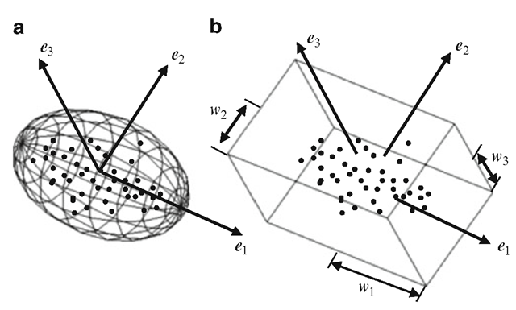
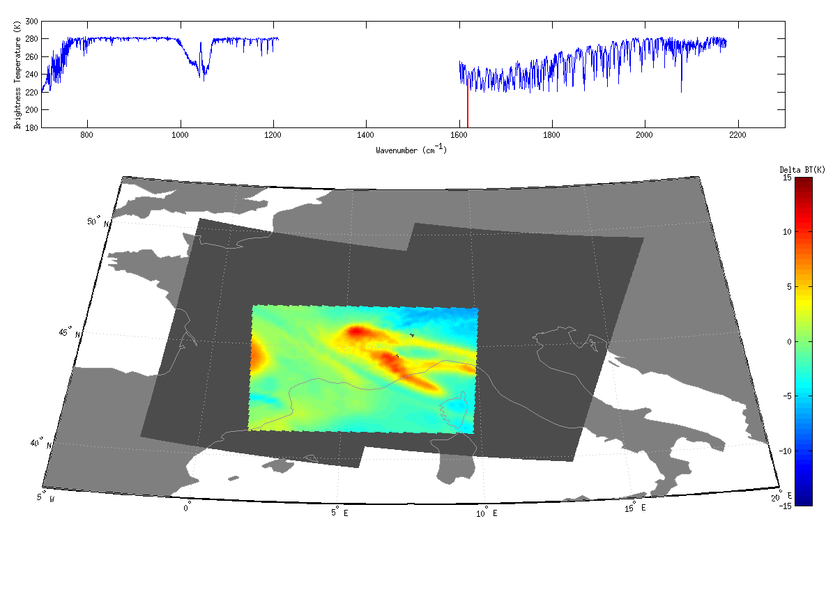
Huge amount of data ➔ PC compression needed
IRS L1b spectrum
eigenvectors
PCS
Atmospheric signal
+ noise
...
Residuals
Noise
Global
Local
... as done with IASI on
Metop-A/-B
 | Global | Local
User | Static EV basis | New EV basis / dwell
 | (PCS + quality indicators)/pix | (PCS + quality indicators)/pix + EV/dwell
 | Less noise in leading PCs Weak signal distinguished from noise | More noise in leading PCs Less noise/signal separation
 | New features not retained in PCS ➔ EV basis update may be required | All local “strong enough” signals retained in leading scores

Slide 20
Hybrid PC approach for the level 1 products
New methodology: Distribution global PCs on a stable (fixed) basis + n local PCs to capture possible outliers, called Hybrid approach.
Experiments have been done on 4 case studies to validate the number of local PCs: 5 local PCs allow to completely capture the atmospheric signal
For example, the local PCs are good to capture the trends at 923 cm-1 (CFC-12) and at 948 cm-1 (SF6)

Slide 21
IRS level 2 processing
IRS Level 2 processing uses the IASI heritage
Similar types of measurements for IRS (assuming L1 SRF uniformisation)
IRS spectral band are within IASI spectral bands
IASI L2 operational products are globally validated and reliable
CPU-wise, IASI L2 processing is very efficient
Maintainability across EUMETSAT hyperspectral missions
IRS specifities, needing immediate assessment:
IR-only, no micro-wave companion ➔ more sensitive to clouds
Coarser spectral resolution/coverage ➔ sounding precision, AC/AQ detectability
viewing geometry ➔ high local zenith angles, quasi-limb view
Data volume: ~100x more than IASI ➔ CPU-effective processing required
Opportunities for future:
High spatial resolution
High temporal repetition
Complementarity GEO/LEO

Slide 22
Current activities at EUMETSAT
New challenges:
  Development for IASI-NG mission:
    Combined MW and IR Soundings for Cloud Properties from IASI/IASI-NG
  Development for IRS mission:
    IRS Retrievals and Applications at high Satellite Zenith Angle
Processings consolidation:
  Expertise support for the L1 activities:
    IRS level 1 processing specification consolidation
Interactions with the users to get them ready, understand their needs and enhance the level 2 products:
  L2 products assimilation:
    Assimilation of IASI L2 Products into a Regional Model (Meteo-France)
    Hyperspectral InfraRed L2 data assimilation into the ECMWF model
  Experience with NWC community:
    Detection and Monitoring of Instability with IASI
    Hyperspectral sounding for severe storm forecasting
  Considering reconstructed radiances for NWP and Air Composition/Air Quality

Slide 23
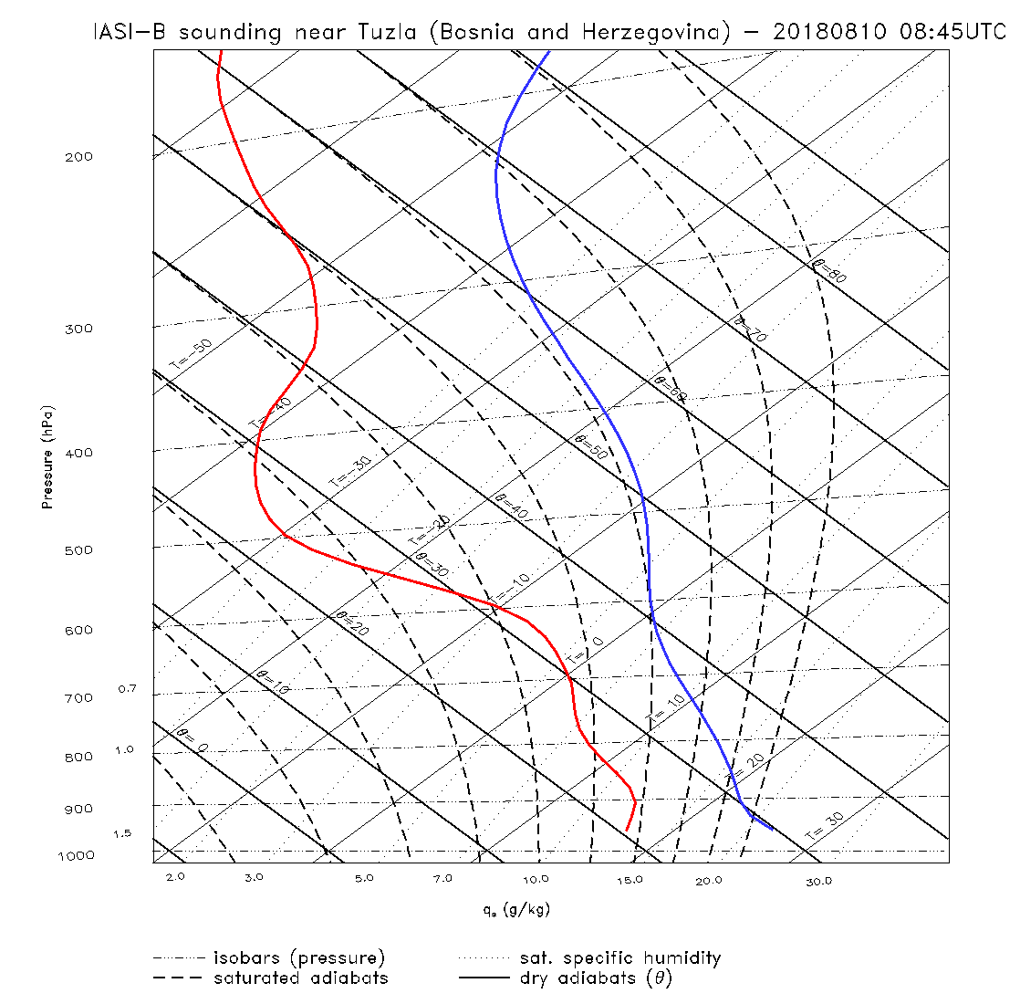


Conditional instability with IASI?
EL
CAPE
Instabilities can be seen with IASI profiles
LFC
CIN
LCL

Slide 24
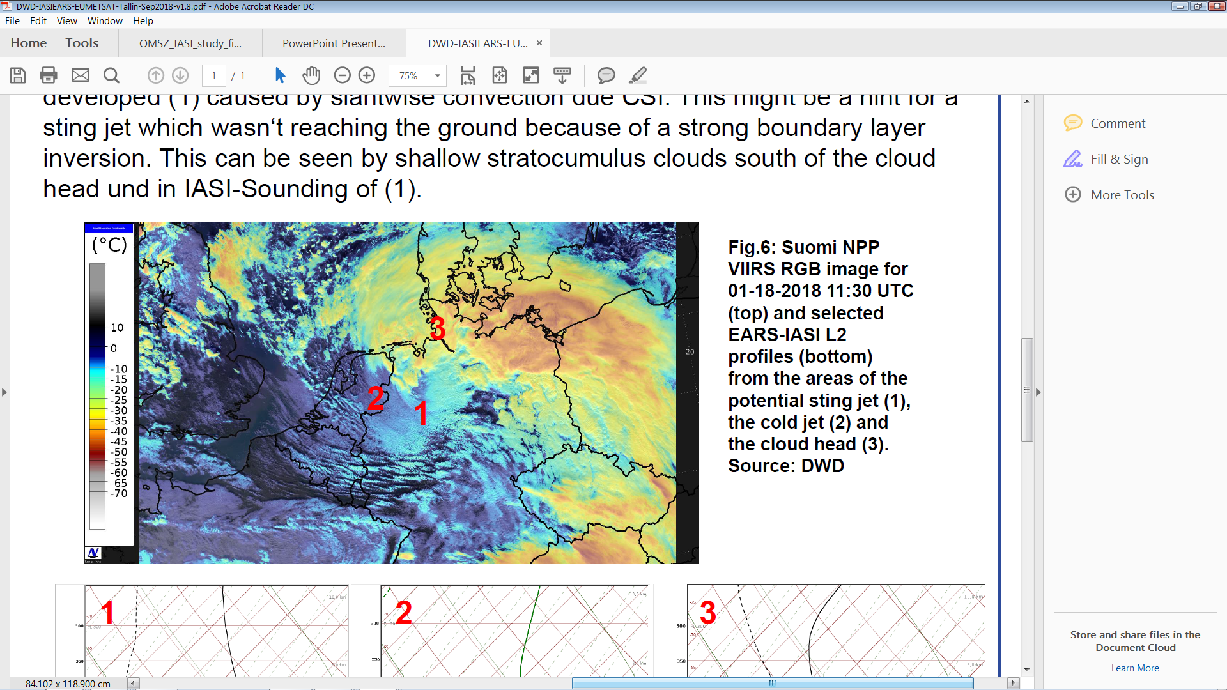
“Are EARS-IASI L2 useful for Nowcasting?”
Case studies at DWD, EUM User Conference, Tallinn 2018
Cyclone Frederike 18/01/2018
(1 out of 3 cases)
Situation: The regional model COSMO-DE predicted the development of a sting jet with gusts up to 170 km/h. The challenge for the forecaster was to decide if the sting jet would reach the ground resulting in fatal wind gusts.
1
Credits: K. Hungershöfer et al. (DWD)
“Are EARS-IASI L2 products useful for Nowcasting?”
EUM User conference, Tallinn 2018
Conclusion:
COSMO-DE overestimated the gusts, but the stratocumulus clouds in the satellite picture and the IASI-Soundings (showing strong boundary layer) gave hints that the Sting Jet wouldn’t reach the surface in the low lands.
EARS-IASI L2 profiles

Slide 25
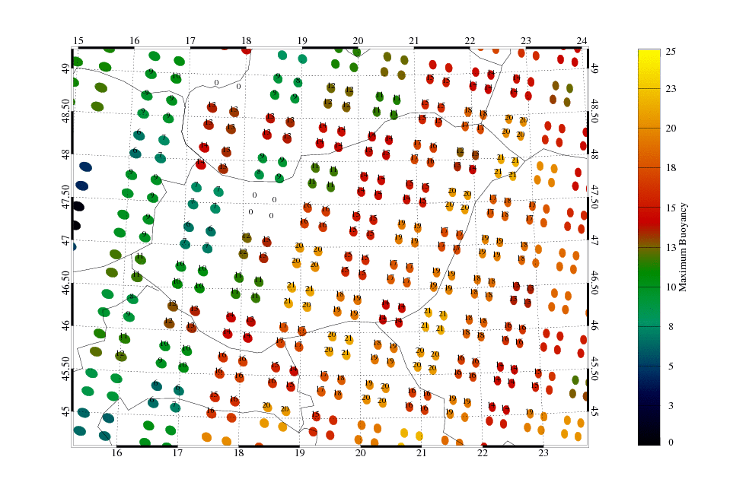
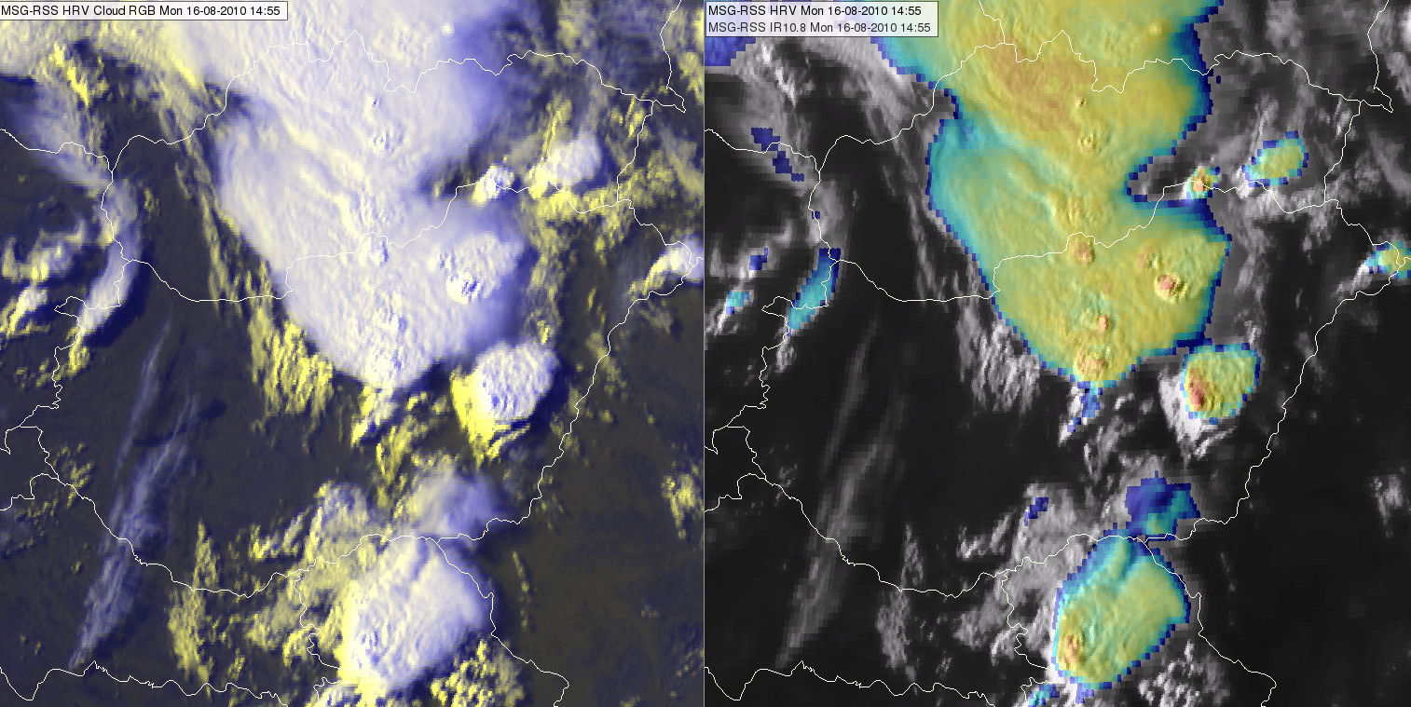
Tracking instability with IASI L2 products, a study with the Hungarian Met Services (OMSZ)
Tornadic storm, 16 August 2010
Cold front
Area with high instability
15:00 UTC
IASI L2 – Maximum Buoyancy (0823 UTC)
Study by Hungarian Met Services
Credits: A. Simon, Z. Kocsis , M. Putsay

Slide 26
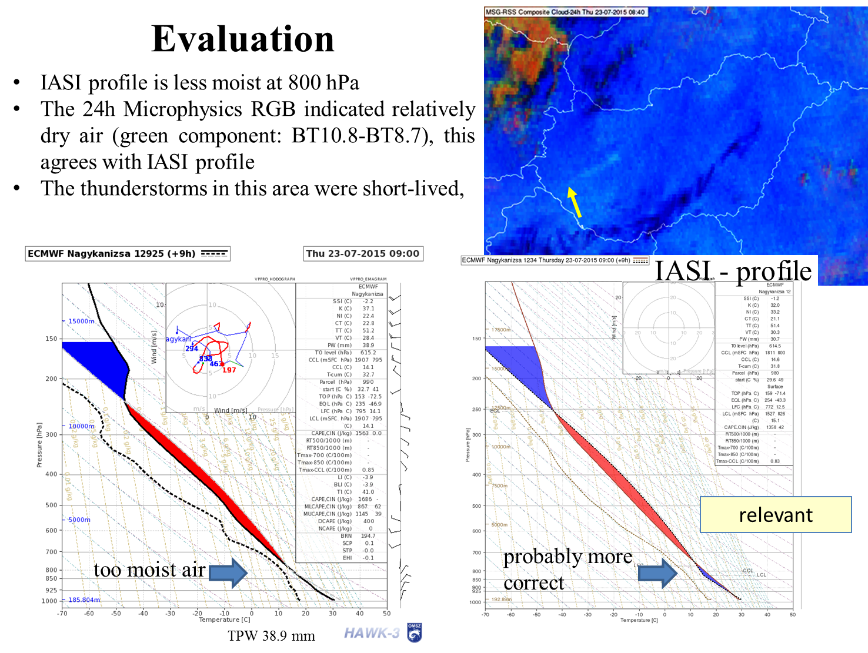
“Possible Usage of IASI L2 Profiles in Nowcasting”
Study with OMSZ, EUM User conference, Tallinn 2018
IASI profile is dryer and closer to reality
Forecasts
IASI profiles
TPW 30.7mm

Slide 27
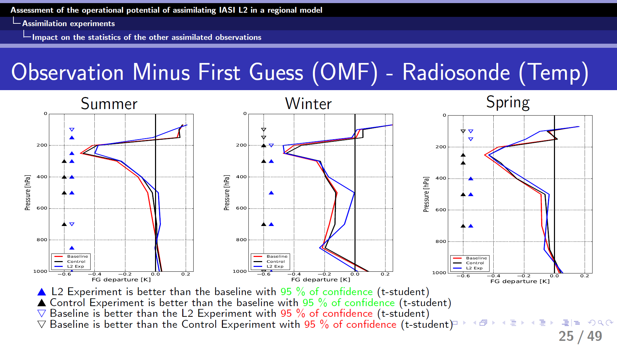
IASI L2 Assimilation study in AROME (Météo-France)
Study team: B. Silveira, V. Guidard, N. Fourrié

Slide 28
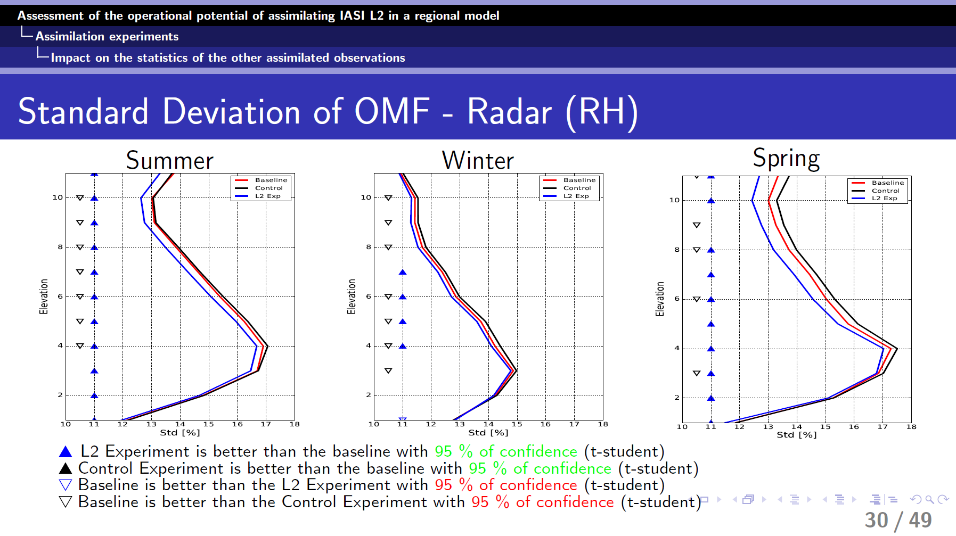
IASI L2 Assimilation study in AROME (Météo-France)
Study team: B. Silveira, V. Guidard, N. Fourrié

Slide 29
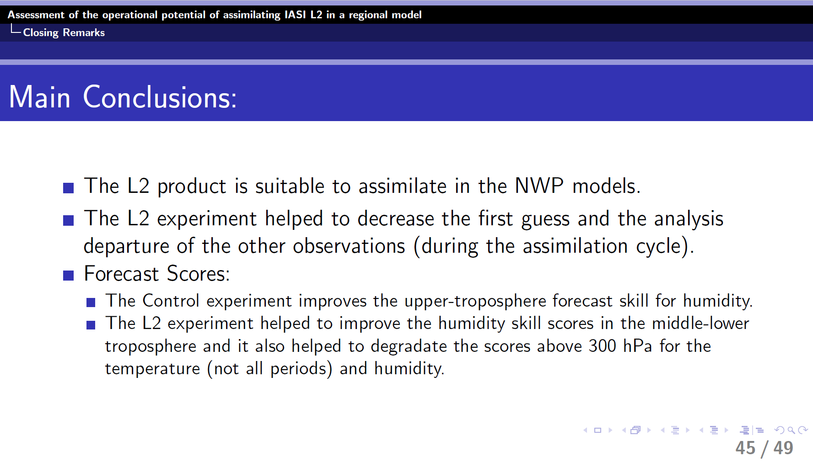
IASI L2 Assimilation study in AROME (Météo-France)
Study team: B. Silveira, V. Guidard, N. Fourrié

Slide 30
Conclusion
Future missions: Lots of effort are put to prepare the future hyperspectral infrared missions, maximising maintainability across missions, interacting closely with the users community.
L1 PC methodology has been optimised to capture the maximum of signal
  ➔ Activities will start to motivate NWP and Air Composition/Air Quality communities to consider reconstructed radiances
IASI-EARS L2 processing is in a pilot phase since November 2017:
    The processing is time efficient to be used by NWC
    It is currently experimented for L2 assimilation, nowcasting and severe events forecasting ➔ showing promising results

